Slide 1
Telescoping Architectures: Evaluating Next-Generation Heterogeneous Computing
Konstantinos Krommydas, Wu-chun Feng
Synergy Lab
Dept. of Computer Science
Virginia Tech
Presented by Pavan Balaji, Argonne National Laboratory
Notes:
0:11

Slide 2
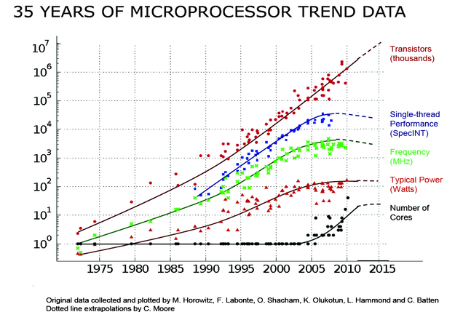
Motivation
Single-Core Computing
Multi-Core Computing
Heterogeneous Computing
General-purpose core → Specialized core
Notes:
Up to ~2005 extra transistors (Moore’s law) used for increasing single-thread performance, and frequency (“free lunch”).
Limitations in transistor scaling, heat dissipation, power/energy constraints, …
as Moore’s law keeps holding, use extra transistors to multiple cores.
Homogeneous (at first) → Heterogeneous (later)

Slide 3
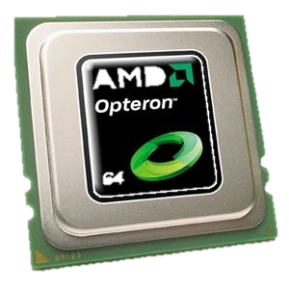
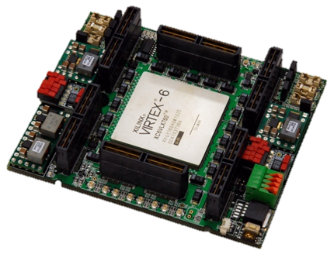
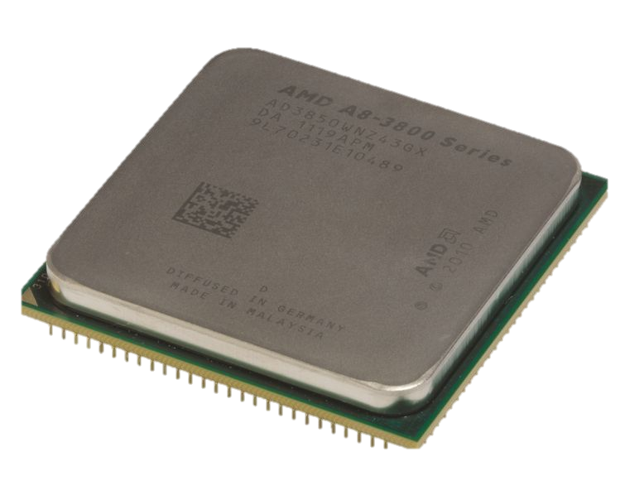
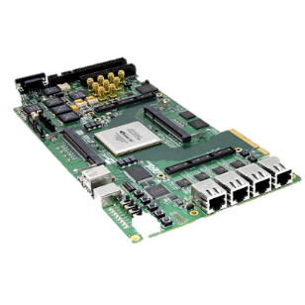

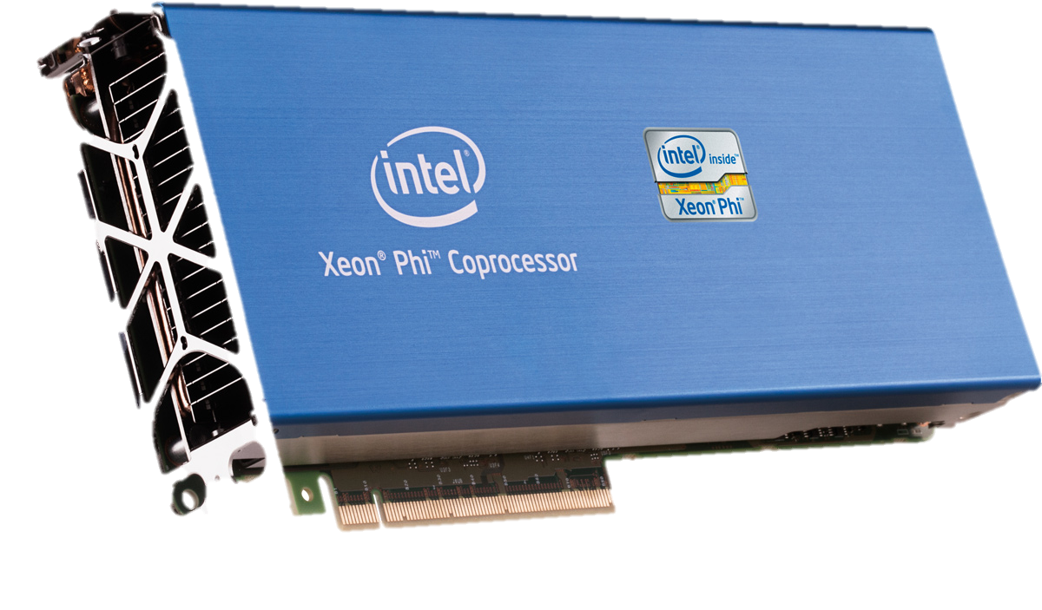
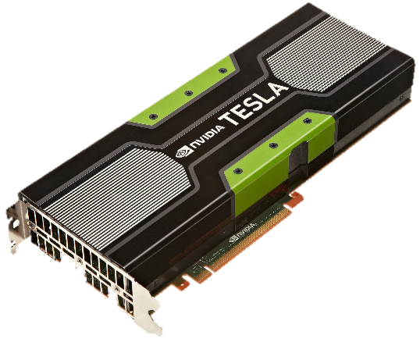
Heterogeneous Computing Landscape: Now
CPUs
FPGAs
GPUs
Co-Processors

Slide 4
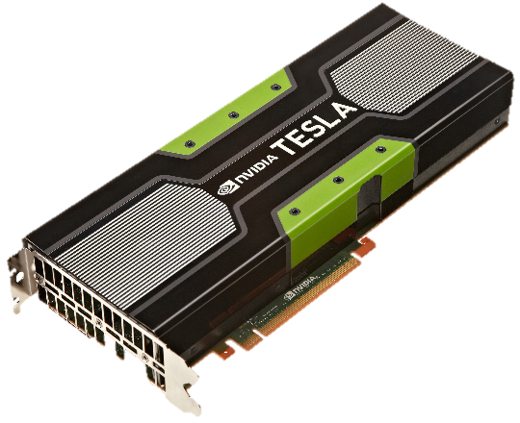
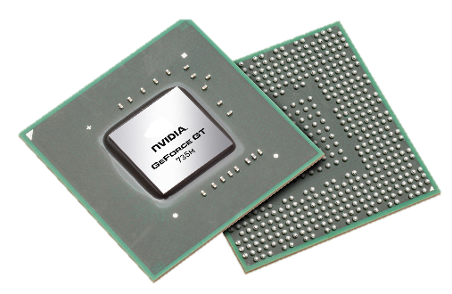
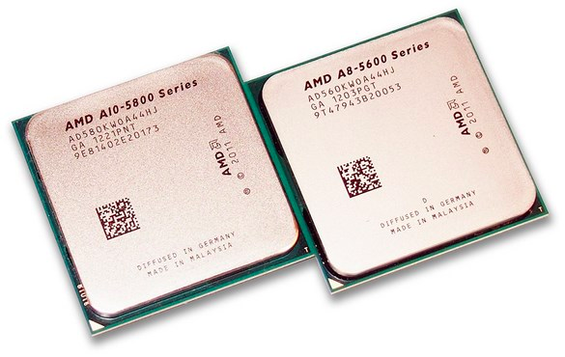
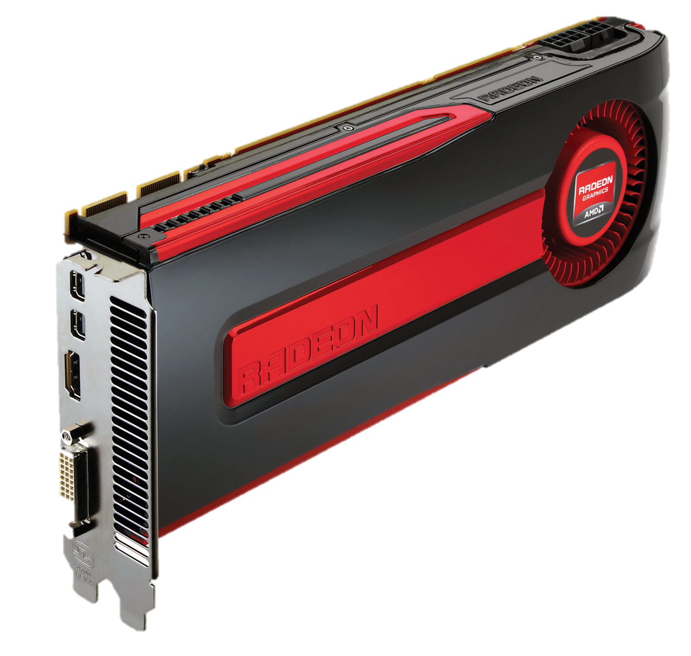
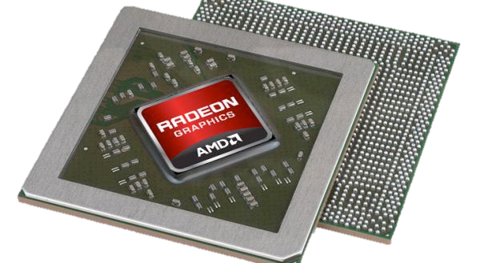
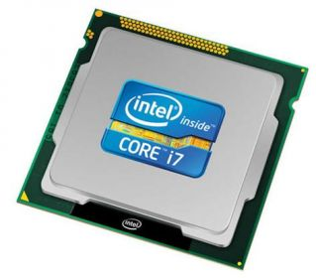
“Unification” Trend: Heterogeneous Coupling
Accelerated Processing Units (APUs)
Discrete GPUs
Integrated GPUs
Notes:
(Intel Core i7-4980HQ Onboard Graphics: Intel Iris Pro Graphics 5200)

Slide 5
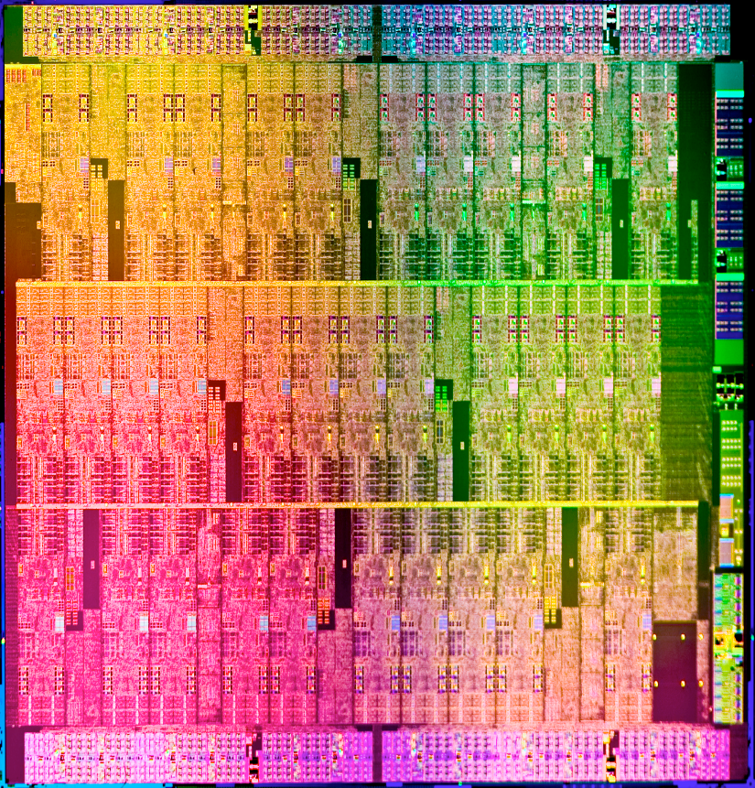
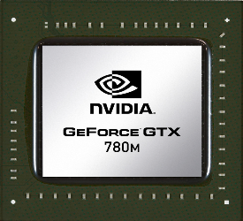
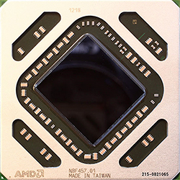
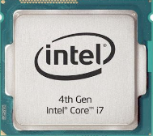
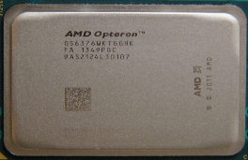
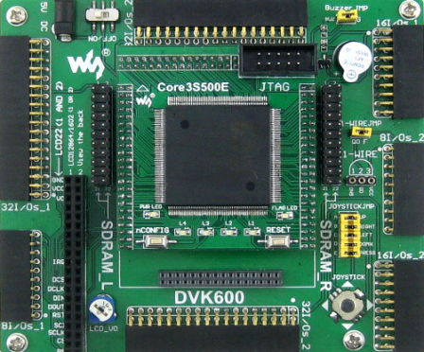
Heterogeneous Computing Landscape: Future
Can we use past trends that have guided computer
architecture innovation to predict the future?
“Unification”
Trend
homogeneous cluster → homogeneous cluster on a chip
heterogeneous cluster → heterogeneous cluster on a chip

Slide 6
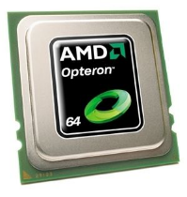
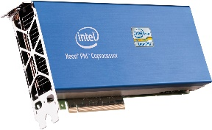
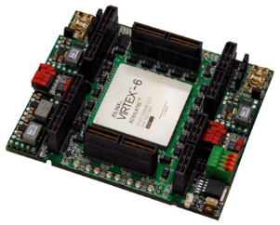
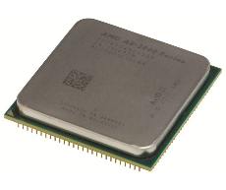
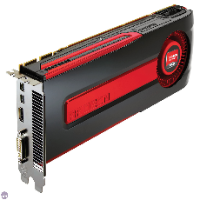

Research Questions
What is the ideal mixture of Compute Engines (CEs) – types and their numbers – in a Cluster on a Chip (CoC)?
Hardware Architect
?

Slide 7
Research Questions
What methodology should we
use to answer the previous question in a systematic and generalizable way?
Hardware Architect

Slide 8
Methodology: Cluster on a Chip (CoC)
CoC:
Combination of discrete types and numbers of compute engines (CEs)
Types:
CPU, GPU, Intel MIC, FPGA
Numbers:
Variable but based on total chip area constraint
A (hypothetical) CoC

Slide 9
Methodology: Chip Area Constraint
To restrict the CoC search space, we enforce an (arbitrary)
chip area constraint:
Base Unit (BU): Relative measure of chip area size based on: Number of transistors & process technology
Type | Model | Trans. (bill.) | Process (nm) | Base Units
CPU | AMD Opteron 6272 | 2.4 | 32 | 1
GPU | AMD Radeon HD 7970 | 4.3 | 28 | 1.37
MIC | Intel Xeon Phi P1750 | 5 | 22 | 0.98
FPGA | Xilinx Virtex-6 LX760 | 5.8 | 40 | 3.78
max_area = area(1 CPU + 1 GPU + 1 MIC + 1 FPGA) = 7.13 BU

Slide 10
Methodology: Performance Evaluation using Dwarfs
“Traditional” benchmarks
Used to evaluate compute devices
Stress subsystems of compute devices (e.g., memory, processor) or different capabilities within a compute device (e.g., integer, floating point arithmetic)
Too specific → Cannot capture trends in parallel computing
Benchmarks ⬄ Scientific Paradigms*
What are the important problems across scientific domains?
What are the sets of accepted solutions?
Berkeley dwarfs** (or motifs)
Capture patterns of computation and communication
*S.E. Sim, et al., “Using Benchmarking to Advance Research: a Challenge to Software Engineering,” ICSE 2003
**Asanovic, et al., “The Landscape of Parallel Computing Research: A View from Berkeley,” Technical Report UCB, UC Berkeley, 2006.

Slide 11
OpenDwarfs: A Dwarf-Based Benchmarking Suite
Available at: http://github.com/opendwarfs
Simple build system
Extended set of run options
Results output
Open-source
Well-documented
Well-structured extensible libraries
Portability
Fairness
OpenCL-based
Cross-platform support (including FPGAs via Altera OpenCL and SOpenCL)
Usability
Uniformly optimized dwarfs
No platform-specific optimizations
Extensibility
Feng, et al., “OpenCL and the 13 Dwarfs:
A Work in Progress,” ICPE 2012
Notes:
(OpenDwarfs plug)

Slide 12

Methodology: Performance Evaluation
Dwarf-based benchmarking
Dwarf | Algorithm
N-body methods | GEM
Dynamic programming | NW
Structured grids | SRAD
Graph traversal | BFS
Combinational logic | CRC
Sparse linear algebra | CSR
K. Krommydas, M. Owaida, C.D. Antonopoulos, N. Bellas, W. Feng , “On the Portability of OpenCL Dwarfs on Fixed and Reconfigurable Parallel Platforms,” J. Signal Processing Systems (JSPS),Springer, 2015
Notes:
*We use the results of running the dwarfs across CPU/GPU/MIC/FPGA as obtained in our paper (previous work) noted at the bottom.*

Slide 13

Methodology: Performance Evaluation
Dwarf-based benchmarking
Synthetic benchmarks
Contain all possible combinations of the dwarfs (3-, 4-, 5-, 6-mers)
Dwarfs can run in parallel across CEs of a CoC
Evaluation
Execute on CoCs
Average results of N-mers (for each N)
Notes:
Synthetic benchmarks that include all combinations of 3, 4, 5, 6 - out of the 6 dwarfs explored.
Each dwarf can run in parallel *within* a CE, and all dwarfs in a synthetic benchmark can run in parallel in the CEs of a CoC.
(see details in paper)

Slide 14
Methodology: Scheduling
Oracle (multiple CEs active at a time)
0
2
3.5
M₀:
M₁:
M₂:
J₀ (Job 0)
J₁ (Job 1)
J₂ (Job 2)
A priori knowledge of execution times across CEs
Off-line scheduling algorithm
Globally optimal solution – upper performance bound on CoC
Notes:
As mentioned in previous slide, each dwarf within the synthetic benchmark can run in parallel (in itself *within* a CE, and with respect to the other dwarfs within the synthetic benchmark across CEs).
Note: this is an assumption. This is not a scheduling paper.

Slide 15
Methodology: Assumptions
Data transfers/Network on chip
Unified memory (a la CPU + GPU in APU)
Prediction/scheduling
Oracle/off-line scheduling
Power
Power is not addressed
Parallelism within applications
Request-level parallelism paradigm
Notes:
(Similar assumptions also appear in related work, like the ones showed earlier)

Slide 16
Results: Overview
Our experiments seek to identify the:
-
Best performing CoCs via a thorough candidate design sweep
Trade-offs between CoC chip area and performance
-
-
Fit of CoCs that include an FPGA

Slide 17
Results: Performance of CoCs
2.1x
1.95x
Notes:
Describe graph/notation (reference baseline).
100 combinations (limited by the area/base-unit constraint).
Irrespective of n (in n-mer) trends are the same → suitability of methodology.
4-mer may be higher when 4 or less CEs (then in 5-,6-mer serialized).
Let’s focus on 6-mer:
Without a GPU performance is only 0.033 to 0.12 → GPU indispensable part of a CoC
With 2 GPUs, not a 2x. Then with 3,4,5 only about 9% better (and SAME). – since overall time capped by longest running dwarf (details in paper)
(Similar observations for other types of CEs.)
Overall performance can be obtained via different CoCs. We see trade-offs later.

Slide 18
Results: Performance vs. Area Trade-offs
3.6x
4.7 BUs
0220
3.7 BUs
0210
1200
Different combinations of CEs in CoCs may achieve the same performance
More CEs are not always beneficial
“Best” choice depends on goal (performance, cost, TDP,…)
…or performance per area
Notes:
Here, we see the same results from a different angle:
300 points (100 CoCs x 3 sets of n-mers, where n=4,5,6)
Three main clusters of points → the higher the n in n-mer, the higher the concentration along the horizontal axis.
For example for 6-mer, the three clusters fall on or near 0.12, 2.18, 3.56x mark.
For the 3.56x speed-up and 6-mer there are 26 CoCs with varying chip area requirements.
Best performance with least area (3.56x with 3.73 Bus) is CoC 0210. – also best performance per area
Second best (same perf, diff area) (3.56x with 3.74 Bus) 1200 – also best performance per area
Third best (same perf, diff area) (3.56x with 4.7 Bus) 0220
Observations:
Different combinations of CEs in CoCs can achieve the SAME performance
More CEs are NOT ALWAYS beneficial
Choice depends on target (e.g., performance, cost, TDP) →
Performance PER AREA may also be an important target (choice may differ from performance alone)

Slide 19
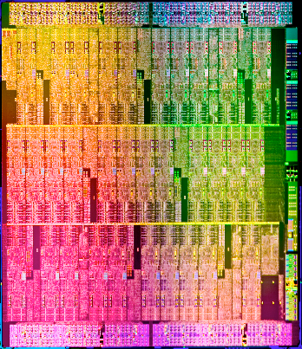

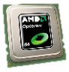
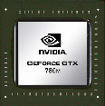
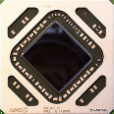
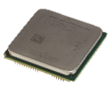
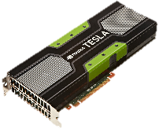
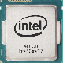
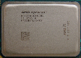

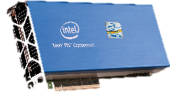
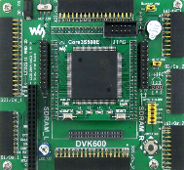
Conclusions
Future: deeper levels of heterogeneity via systems with specialized cores
May not be a complete architectural overhaul → unification of existing architectures
Telescoping Architectures
Methodology for evaluating heterogeneous computing trends
Broad exploration case-study via real hardware

Slide 20


Open Positions at Argonne National Laboratory
Argonne is a Department of Energy National Lab in Chicago
Several open research positions at Argonne in parallel computing: MPI, OpenMP, …
Long-term Graduate Student positions
Postdoctoral researcher positions
Assistant Computer Scientist positions
Software Developer positions
Women researchers and developers are welcome and are encouraged to apply!
Please come and talk to me if you are interested
Don’t just send me a CV over email
Let’s discuss over coffee what you are interested in and see if our interests match

Slide 21
Backup Slides

Slide 22
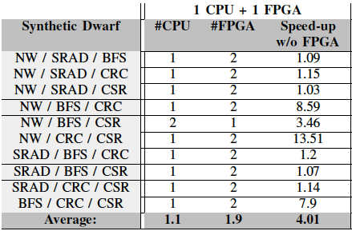
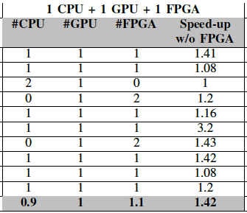
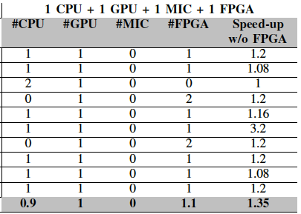
Results: Case-Study: FPGAs in CoCs
Notes:
(Probably need to go fast through this, or hide/skip altogether, due to time constraints)
(Discuss we we have this case-study, FPGAs in the data-center – Amazon/Baidu/…, Intel/Altera, ...)
Simpler, more viable short-term CoCs.
Focus on 3-mers:
(Describe: #CPU, #FPGA, etc.: How many of the 3 dwarfs run on each of each kind, i.e., CPU, GPU, FPGA, …)
(Describe: Speed-up w/o FPGA: speed-up of CURRENT CoC versus the corresponding one but *without* the FPGA)
General comments (details in paper):
1st case: The FPGA is utilized on average twice as much as the CPU!
Average speed-up of 4.01 (varies – in 6/10 cases below 1.2x . SRAD dominates execution time)
2nd case: CPU + GPU (so like ~APU) + FPGA
FPGA still used (at least once) in 90% of cases.
FPGA yields performance benefit: 1.42x on average vs. CPU+GPU alone.
Major benefit from executing SRAD on GPU. Scheduler picks second best for others so long as SRAD goes on GPU.
More scheduling possibilities with more CEs, even if NOT the fastest for the single job (as discussed in above line).
3rd case: CPU+GPU+MIC+FPGA
When adding an FPGA, the MIC is not used in any of the best schedules → It is like previous case.
Granted, 3 sub-dwarfs, so with 4 CEs one won’t be utilized for each case → but the one not used was always the MIC.

Slide 23
Related Work
Kumar et al. [MICRO’03, ISCA’04]: Single-ISA heterogeneous multicore architectures (2 Alpha cores varying complexity, power), simulation based
Chung et al. [MICRO’10]: Single-chip heterogeneous computing, U-cores, the future includes custom logic, FPGAs, and GPGPUs, no mixing and matching
Composite Cores [MICRO’12]: Heterogeneity within a single core, pairs of big & little micro-engines, focused on energy, simulation based
10x10 [ICCS’11, SIGARCH’15]: 90/10 → 10x10, ten specialized micro-engines for 10% cases
[ISCA’04]: “Single-ISA Heterogeneous Multi-Core Architectures for Multithreaded Workload Performance”
[MICRO’10]: “Single-Chip Heterogeneous Computing: Does the Future Incl. Custom Logic, FPGAs, and GPGPUs?”
[MICRO’12]: “Composite Cores: Pushing Heterogeneity Into a Core,”
ICCS’11]: “10x10: A General-purpose Architectural Approach to Heterogeneity and Energy Efficiency”
Notes:
(Maybe move towards the end?)
Related work has identified the need and tried to address various aspects of heterogeneous computing (performance, power, …)
→Kumar: Simulation-based study using 2 Alpha cores of varying complexity and power. *single-ISA*
→Chung: Focuses on “U-cores” (unconventional cores), i.e., custom logic, FPGAs, GPGPUs, alongside a CPU. Only 1+1 – no mixing/matching/more.
→Composite Cores: Simulation-based study focusing on heterogeneity *within* a single core, big-little, focus on energy.
→10x10 (Chien): Move from 90/10 paradigm, to 10x10 paradigm using micro-engines. Simulation-based.

Slide 24
Related Work
How our work differs:
Focus on systematic, generalizable (dwarf-based) evaluation methodology
Based on commodity architectures (vs. designs from “scratch”)
Mix & match; breadth of design space exploration
Special consideration of heterogeneous architectures that include the FPGA
Current focus on performance (instead of power, energy)

